Slide 1
֎ The perfect partner to match your business growth ֎
www.ratespro.travel

Slide 2
Karabakh is Azerbaijan!

Slide 3
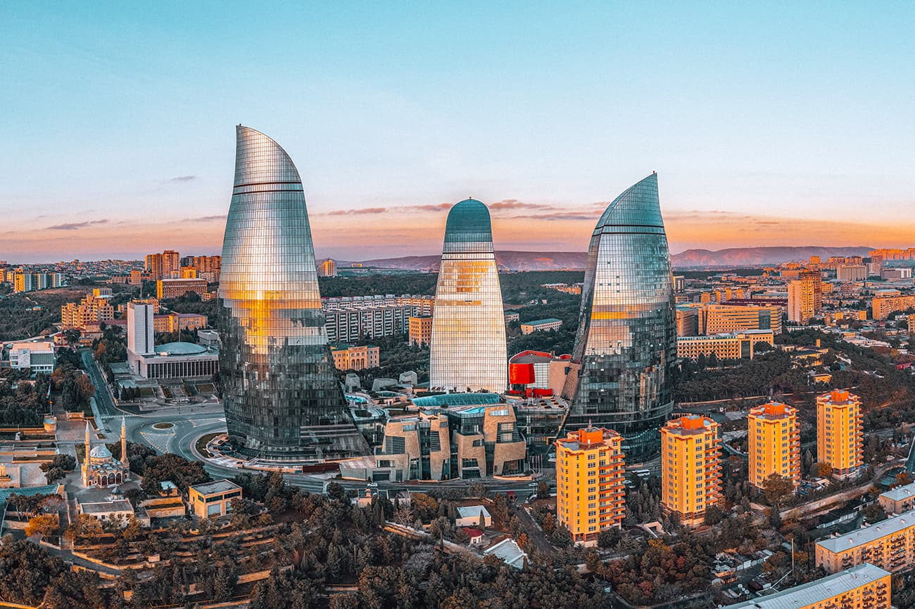
RatesPro Ailəsinə xoş gəlmisiniz

Slide 4
About us
RatesPro is a leading travel wholesaler, established and headquarters in Dublin.
Our accommodation portfolio contains over 1.3 mills. properties along with 30,000 direct contracts.
We distribute FIT & Groups request to more than a thousand travel agencies and direct clients, where our most source market is EMEA & CIS markets.
We work directly with Hotels, Airlines, and global DMCs to get you the best deals.

Slide 5
Our advantages
Technology
We work with state-of-the-art software, designed to cover all the needs of our clients.
Presence
We cover importing markets such as EMEA and AMER regions.
Price
Our large scale of prepayments, guarantees, and strategic alliances allow us to obtain the best conditions.
Customer Support
A key point that diﬀerentiates us from the rest thanks
to strict SLA and Health and Safety policies.
Our Focus
We focus on distributing products that guarantee
competitive rates and exceptional service.
Partners
Our distribution is limited to a select group of companies in each market.

Slide 6
A global partner with local experts in each destination
Local
Our local sales, customer service, and recruitment teams are
true experts in each destination. They are close to you, speak your language, and understand the needs of your customers.
Global
We have an unrivaled team of product sourcing and travel
distribution experts, as well as state-of-the-art technology platforms and a seamless global customer service structure.

Slide 7
Our property portfolio in numbers
LATAM 2,000
Europe & Africa 19,000
Middle East
6,000
Asia Paciﬁc
3,000
HOTELS - RESORTS - APARTMENTS - BED & BREAKFAST - HOSTELS - BOUTIQUE HOTELS - HOMES /VIL AS - APARTHOTELS
All types of properties worldwide
+ 7,000 direct new properties to be added by the end of 2023!

Slide 8
Some of our partners

Slide 9
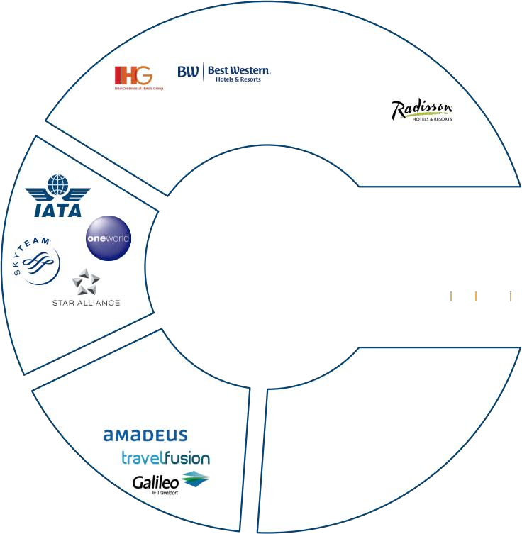
Best available rate in different ways
Our winning formula consists of consolidating the direct purchase of products from various sources in a powerful technological platform that
drives the entire process in real-time, from the search to the online
reservation. This platform is powered by selected providers on six
continents at highly competitive prices, with the continuous help of
the best support centers.
_{Hotel Chains}
Accounting & Payment Integrations

Slide 10
Our clients
Tour Operators
White Labels
Web Agents
OTA's
Corporate Clients
Wholesale Clients

Slide 11
How RatesPro Works
We offer a huge global database of hotels and accommodations around the world
Full up-to-date information with prices and terms from both Tour Operators and Hotels
The booking engine provides instant confirmation and availability
24/7 multilingual customer service center.

Slide 12
Here for you when you need it
We are available to you during oﬃce hours and also for emergencies through our 24/7 multilingual customer service center.
We are committed to providing continually improved customer service in your language by implementing live chat and callback solutions.
And in the event of natural disasters or terrorism, our global network allows us to proactively communicate for your peace of mind.
We reconﬁrm the bookings with hotels and provide the appropriate information to your client.
Our agents speak multi-languages and have the framework to provide you with the best service.
They can be contacted via Skype, Phone, and WhatsApp, and we also provide a local toll-free number* for your market!

Slide 13
Rewarding your growth
Commission ﬂexibility
Choose between commissionable or net rates and customize your margin.
A win-win partnership that rewards your growth and loyalty
We aim to develop long-term strategic relationships and grow together with you while sharing the rewards at all levels (agents, agency owners and larger networks).

Slide 14
Payment options that suit you
Local payment
Each country has its peculiarities in terms of
payment methods. We work with local banks and partners to provide you with suitable options and save you costs and commissions.
Flexible prepaid platform
Our prepaid platform allows you to more
efficiently manage your reservations pending payment and even notiﬁes you when payment dates are due.
Facilities to help you grow faster
When you're producing a large volume of bookings, you need to be as agile and quick as possible. We provide you with a credit facility that meets your needs and accelerates your growth.

Slide 15
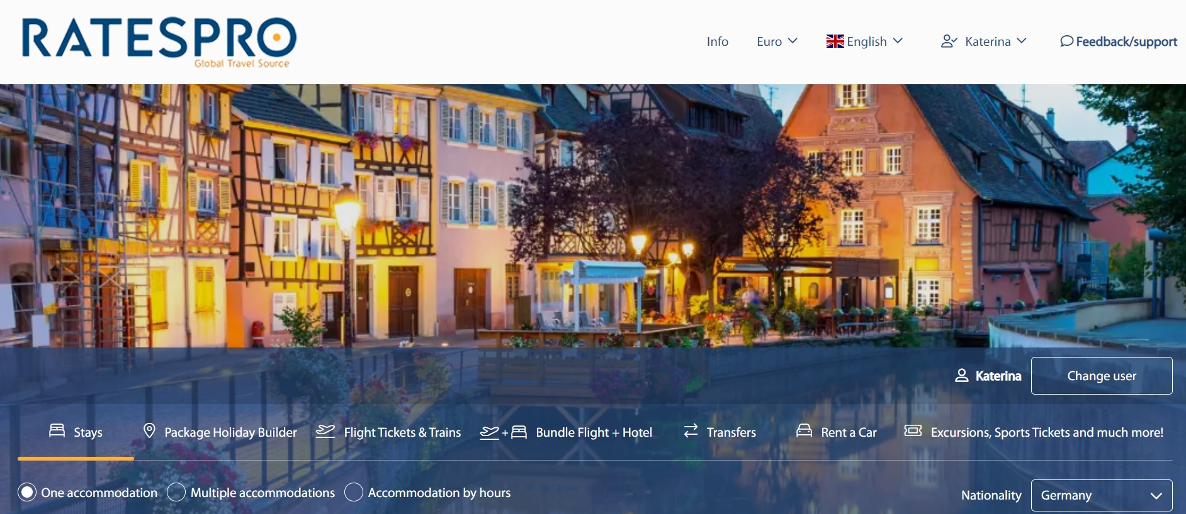
Our product
Accommodation
Transfers
Package Holiday Builder
Flight/Train & Bus Tickets
Excursions, Attractions , Sports Tickets and much more
Car Rental

Slide 16
1 POINT = 1 USD

Slide 17
Focus on growing your business
We take care of the rest.
THANK YOU
dragan@ratespro.travel
katerina@ratespro.travel
+353 1 525 6736
www.ratespro.travel

